Slide 1
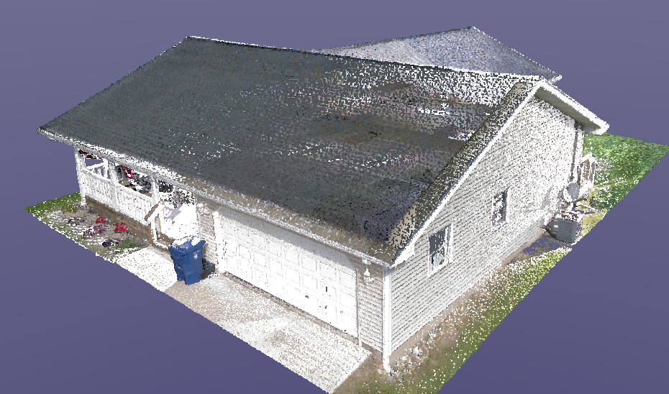
Creation of Build Environment using Point Cloud Data
Presented by: Rishav Pandey ^{1, a)}
Course Instructor: Prof. Col. (Dr.) Pawan Pandey ¹
¹Indian Institute of Technology Delhi, India
^{a)}cec242829@iitd.ac.in
Entry No.: 2024CEC2829

Slide 2
What is Point Cloud Data?
A Point Cloud is a collection of data points in 3D space, usually defined by X, Y, and Z coordinates. It represents the external surface of objects or environments.
It is generated through scanning technologies such as LiDAR or laser scanners.
Why Use Point Cloud for 3D Modeling?
Point cloud data allows us to digitally preserve the exact model of any structure for future reference. For example, if we want to preserve the model of the IIT Delhi Administrative Building, we can perform a comprehensive laser scan of the entire structure, including both its exterior and interior spaces. Later, if we need to reconstruct the building at a different location—or rebuild it on the same site after demolition—we can use this scanned data to recreate an identical model of the original structure with high accuracy.High accuracy and precision in capturing as-built conditions
Saves time in manual modeling
Allows for renovation, retrofitting, and clash detection
Enables BIM (Building Information Modeling) workflows

Slide 3

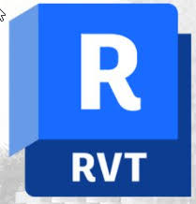
Technologies Involved:
LiDAR (Light Detection and Ranging)
Terrestrial Laser Scanning (TLS)
UAV (Drone) Photogrammetry
Mobile Laser Scanning (MLS)
High-definition scanners (Leica, FARO, Trimble)
Software Used:
1. Autodesk ReCap:
Imports raw scan data (e.g., from LiDAR)
Registers and aligns multiple scan files
Converts data into a structured point cloud (.rcp format)
2. Autodesk Revit:
Imports point cloud (.rcp/.rcs)
Used for creating BIM-ready 3D models
Provides tools for surface tracing and object placement

Slide 4
Workflow Steps:
Data Capture: Using LiDAR or Photogrammetry
Data Registration: Using Autodesk Recap to stitch multiple scans
Cleaning and Trimming: Remove unwanted or noisy data
Import into Revit: Attach .rcp file into Revit project
3D Modeling: Trace architectural and structural elements
Verification and Output: Compare with original data and export
Real-Life Applications
Heritage Restoration: Reconstructing historical monuments using point cloud
Renovation Projects: Accurate modeling of existing buildings
Infrastructure Projects: Railways, bridges, tunnels
Facility Management: 3D documentation of building interiors
Smart Cities: Digital twins for urban planning

Slide 5
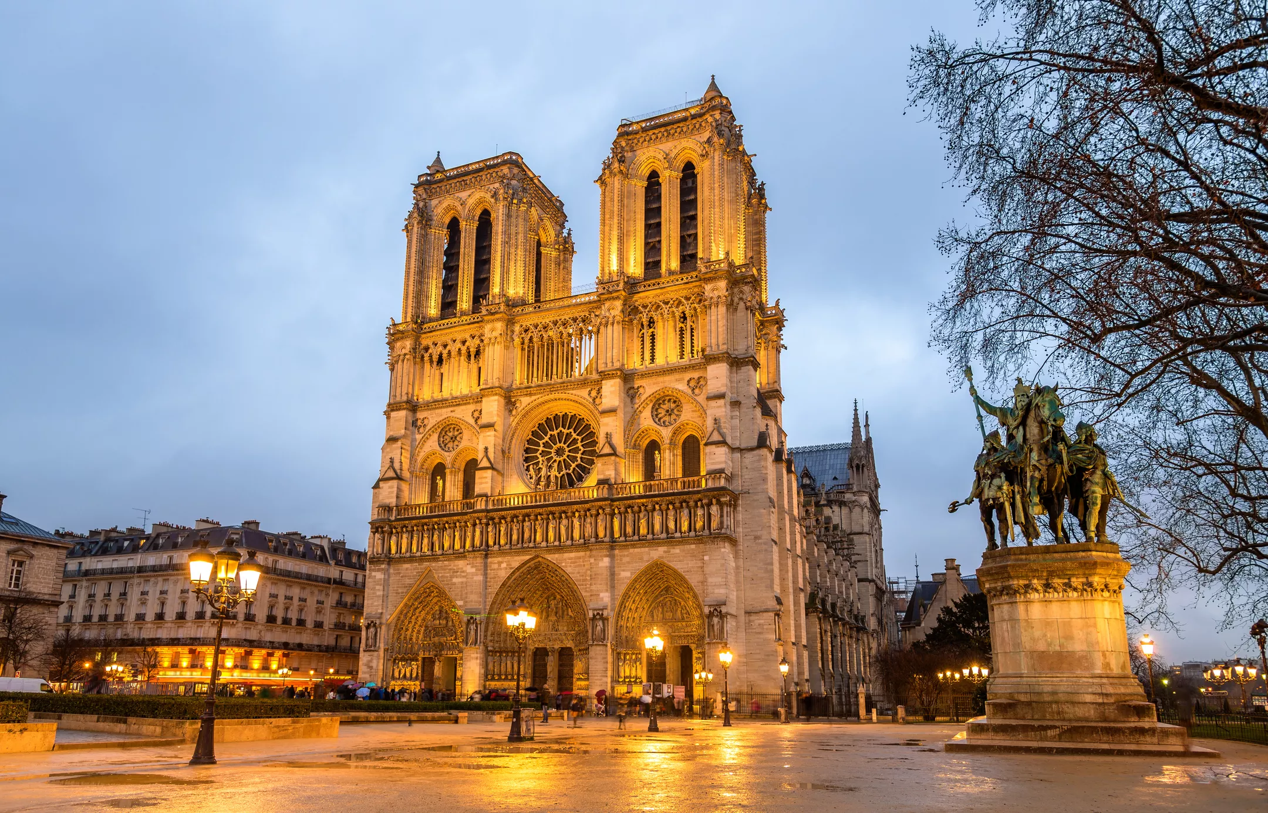
Case Study
Restoration of Notre Dame Cathedral using point cloud data

Slide 6
Modeling of a house using Point Cloud Data

Slide 7
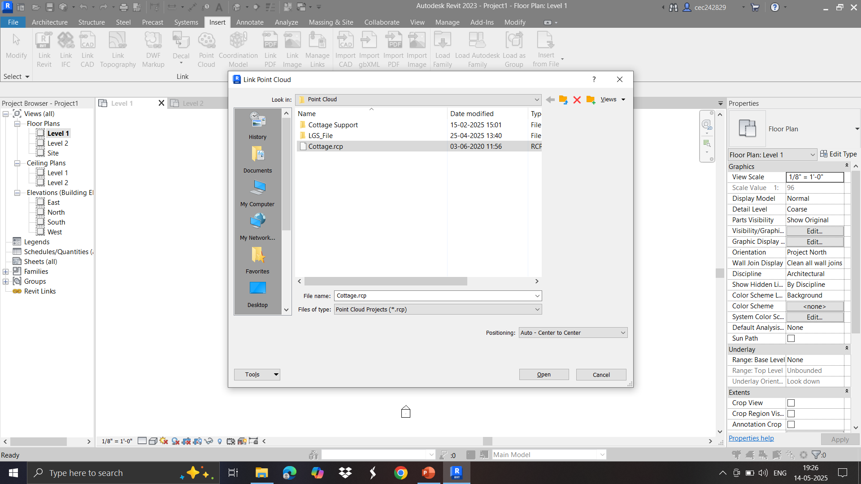
Insertion of Point Cloud Data in Revit 2023

Slide 8
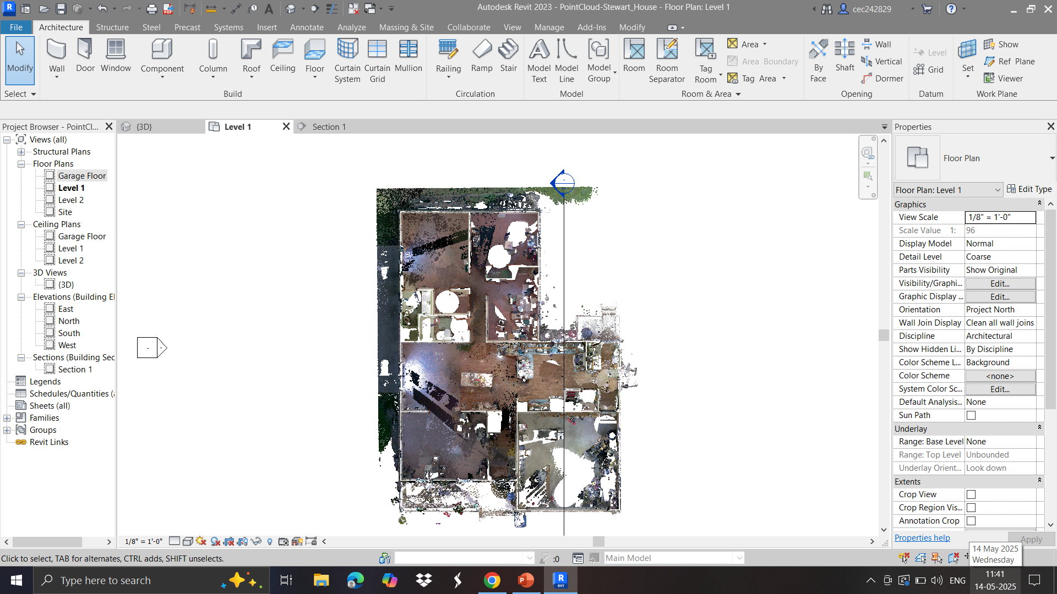
Layout Plan – Point Cloud

Slide 9
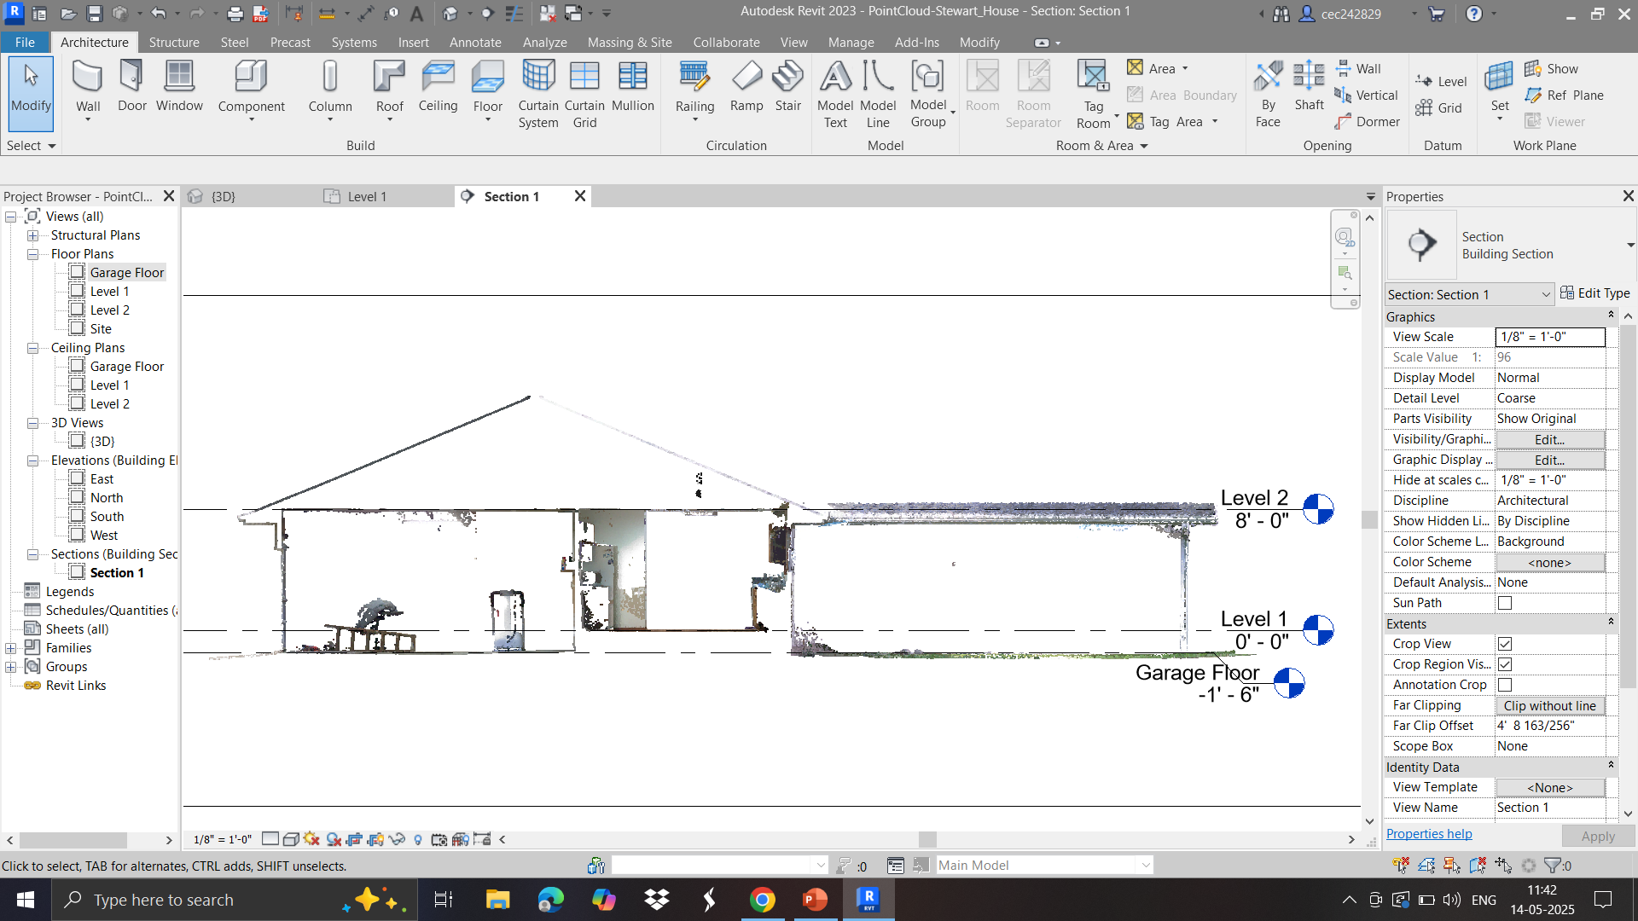
Creation of Section

Slide 10
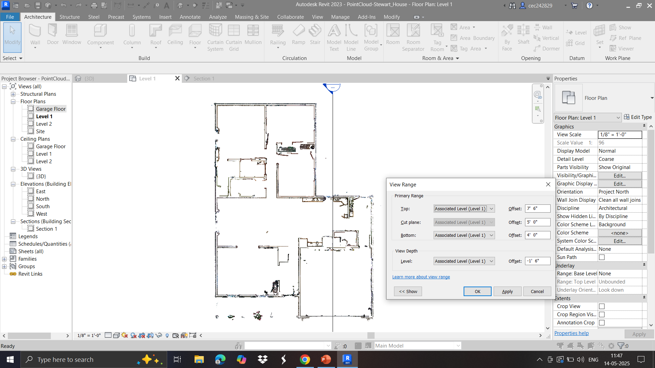
Adjusting View Range

Slide 11
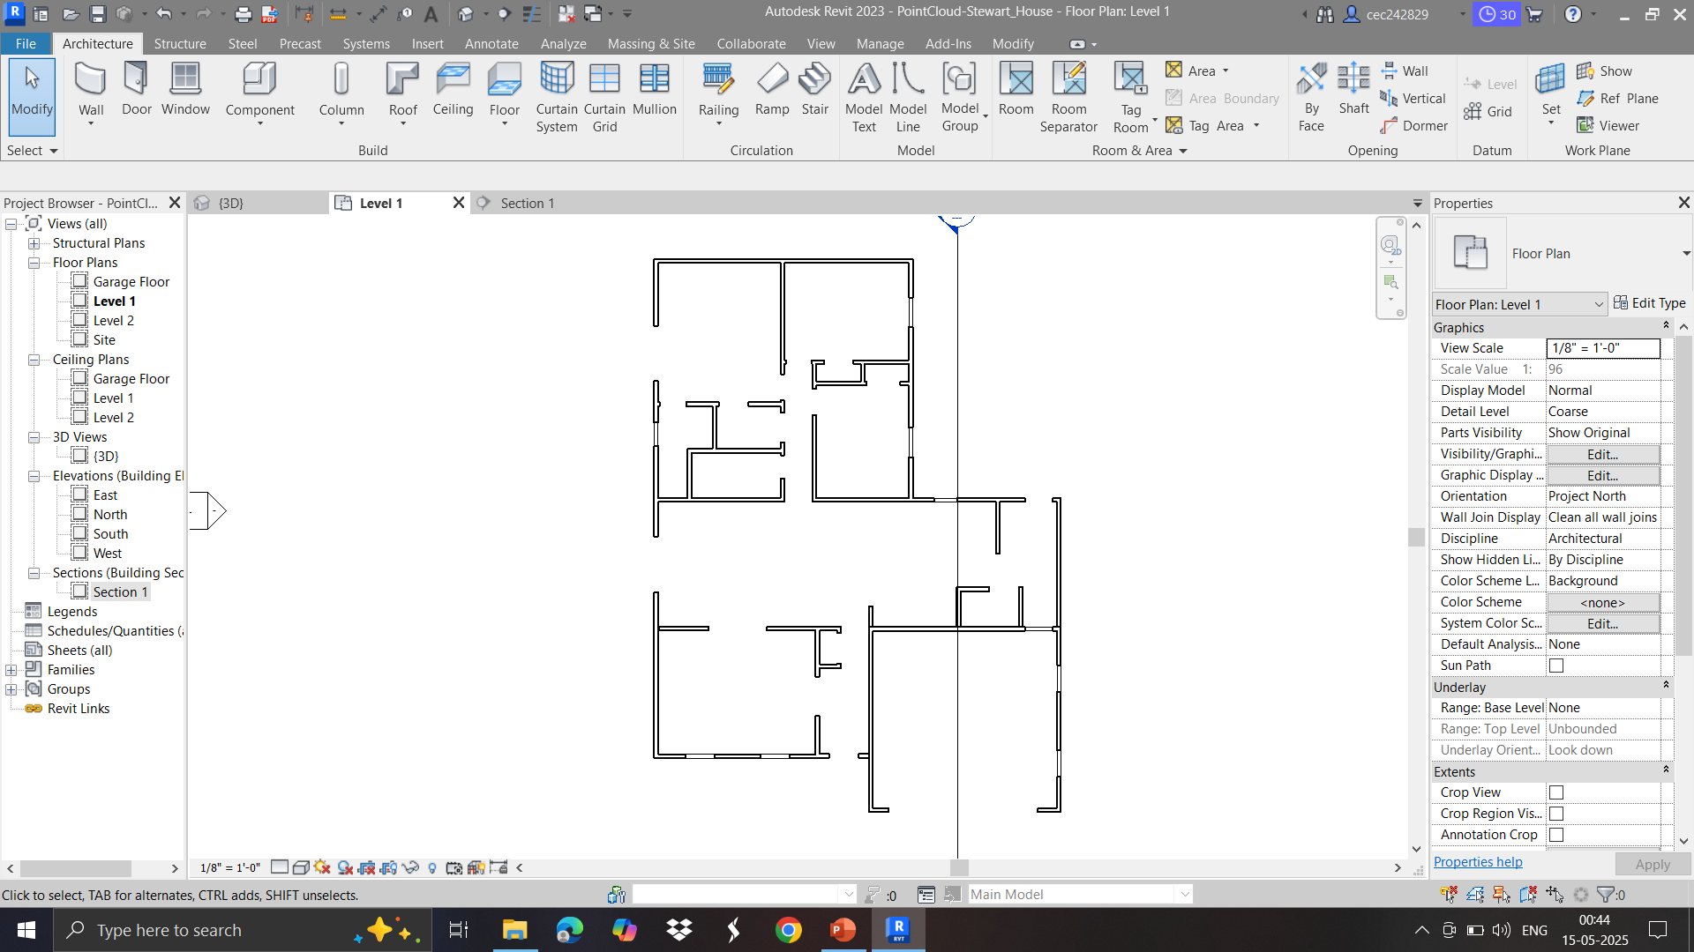
Addition of Walls (2D View)

Slide 12
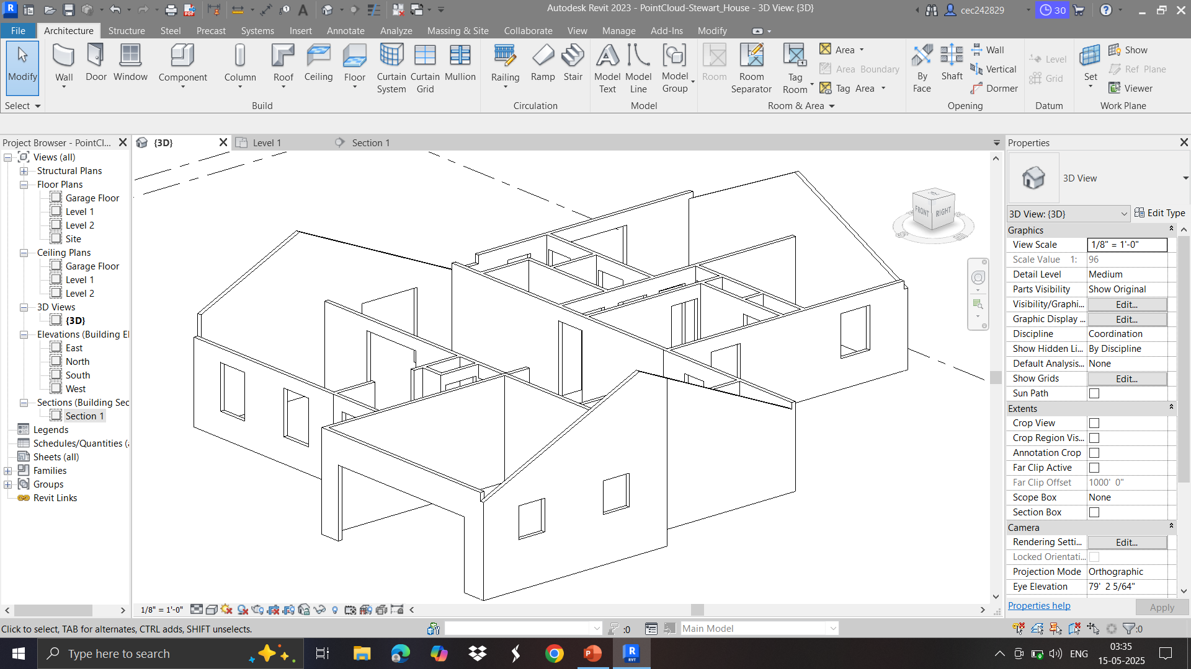
Addition of Walls (3D View)

Slide 13
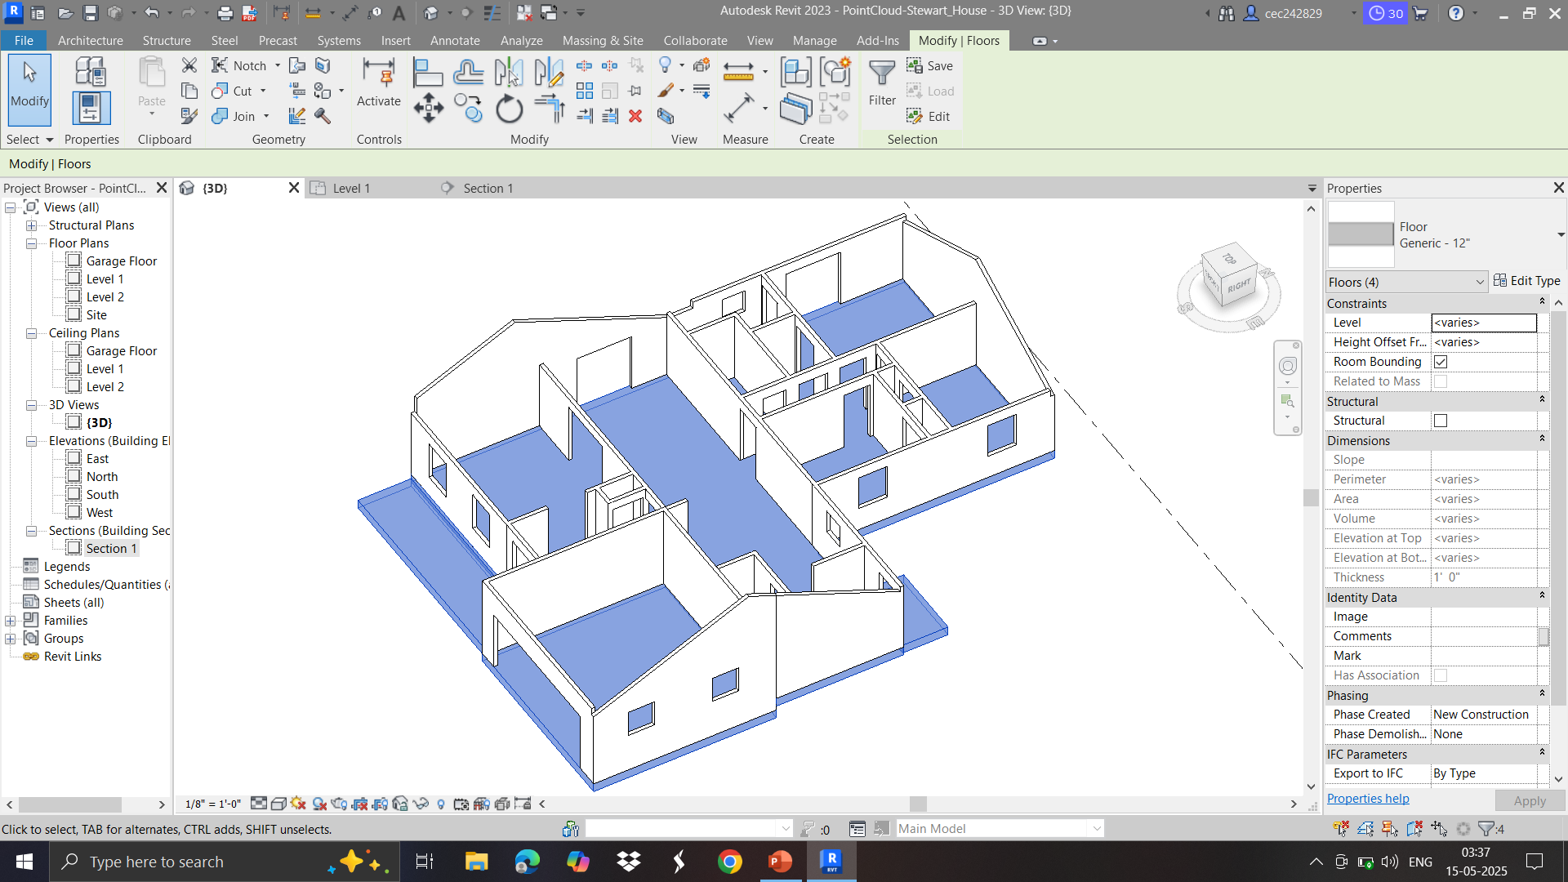
Addition of Floor and Deck (3D View)

Slide 14
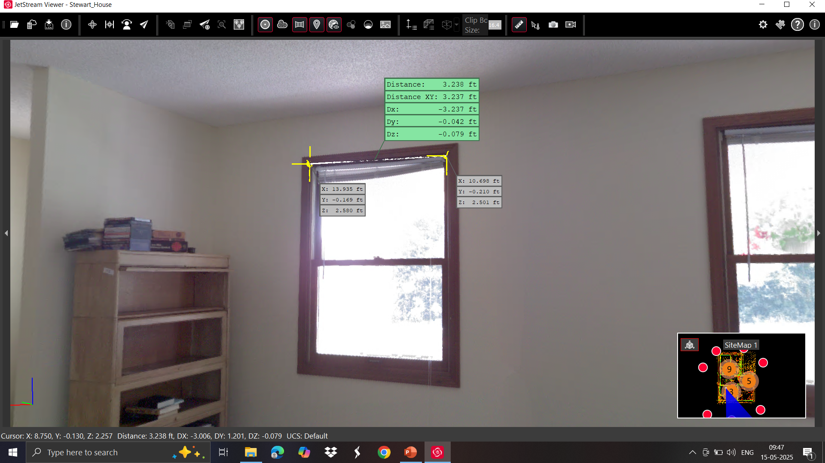
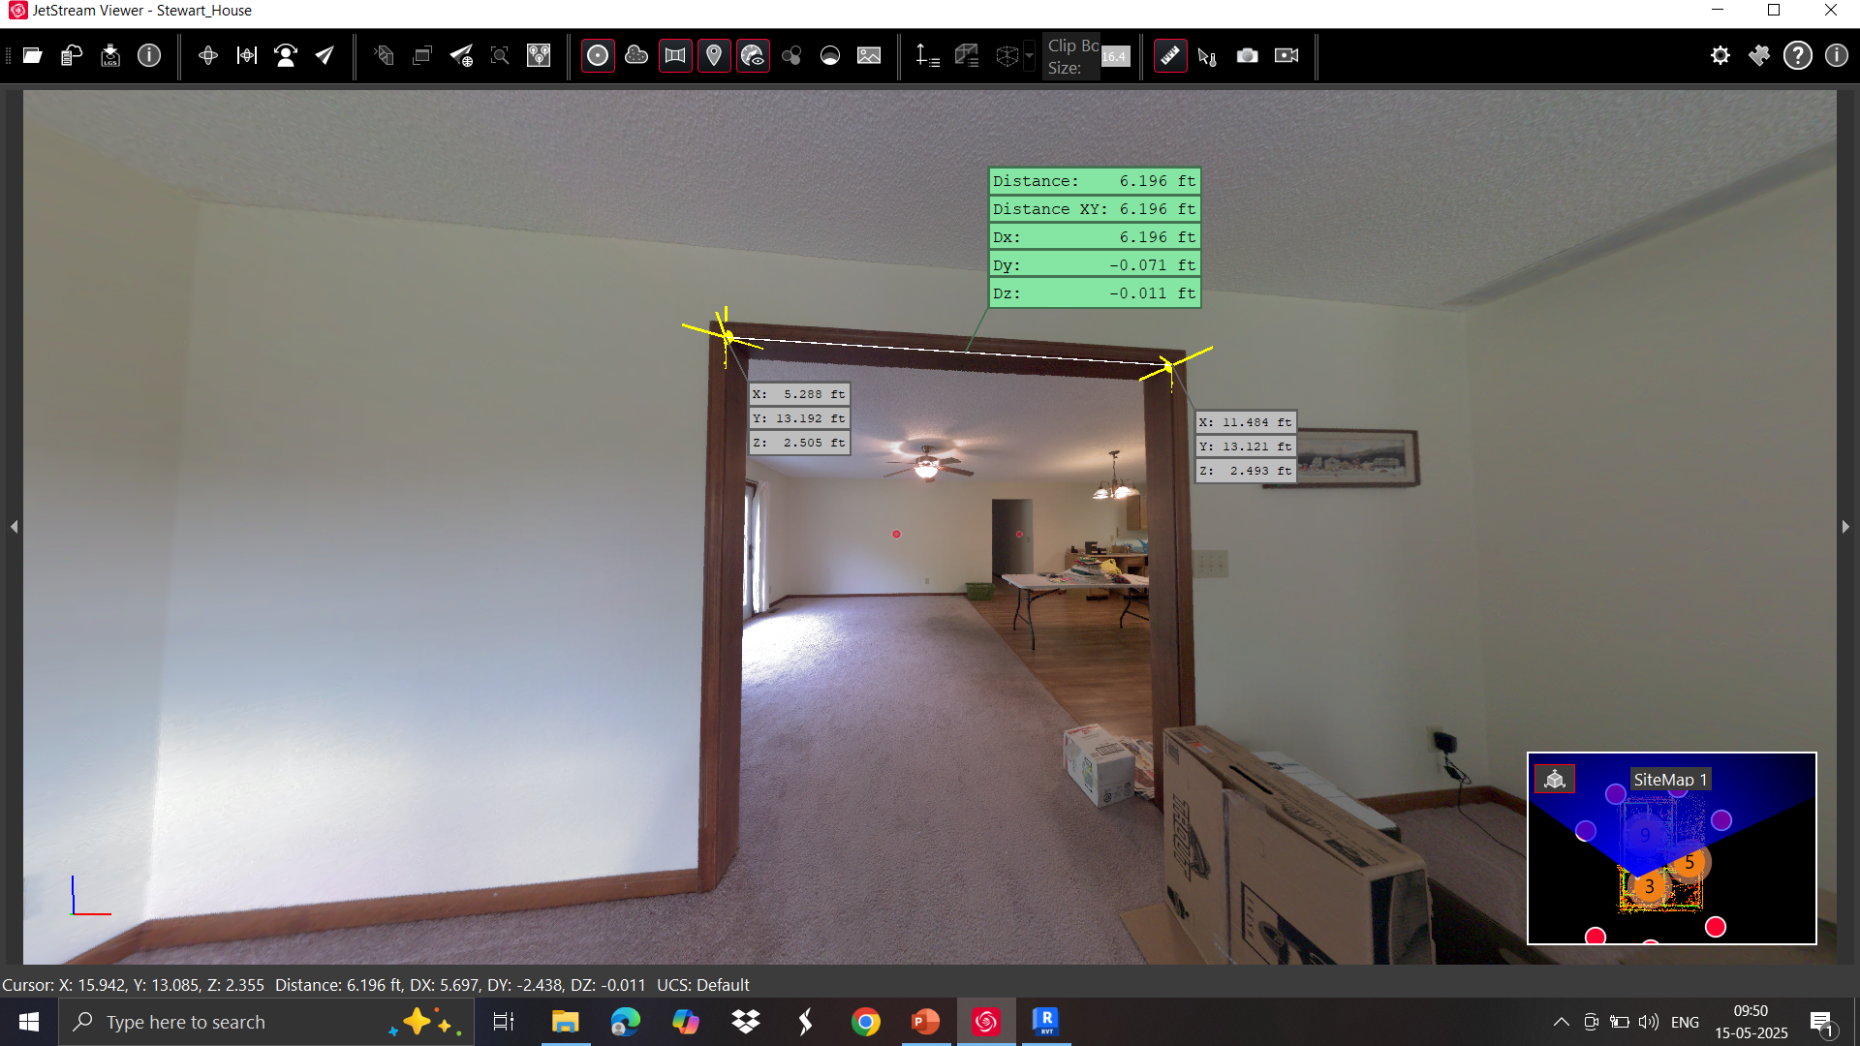
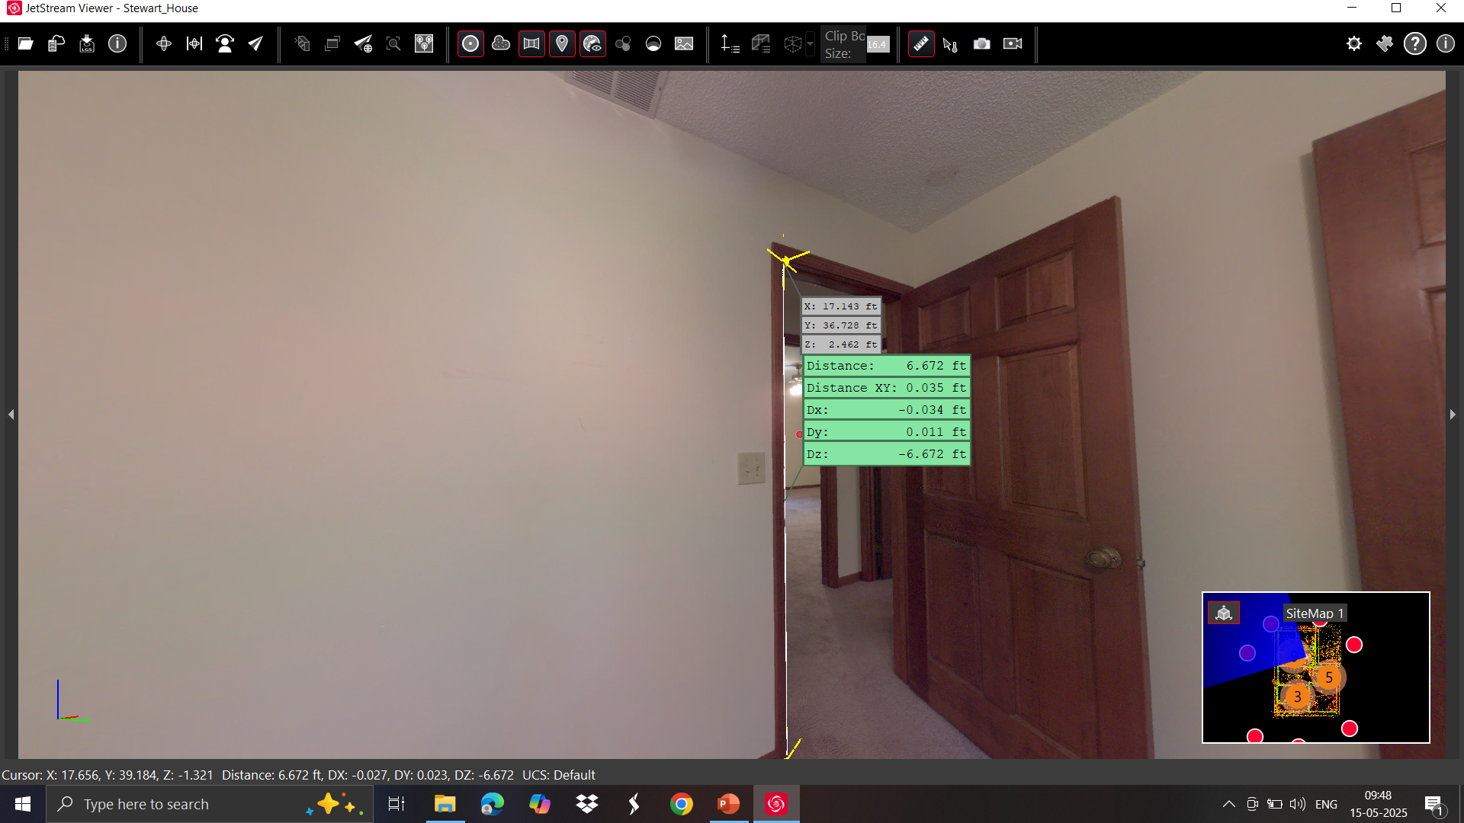
Measurement of Windows, Wall Cuts, and Doors (using LGS file)

Slide 15
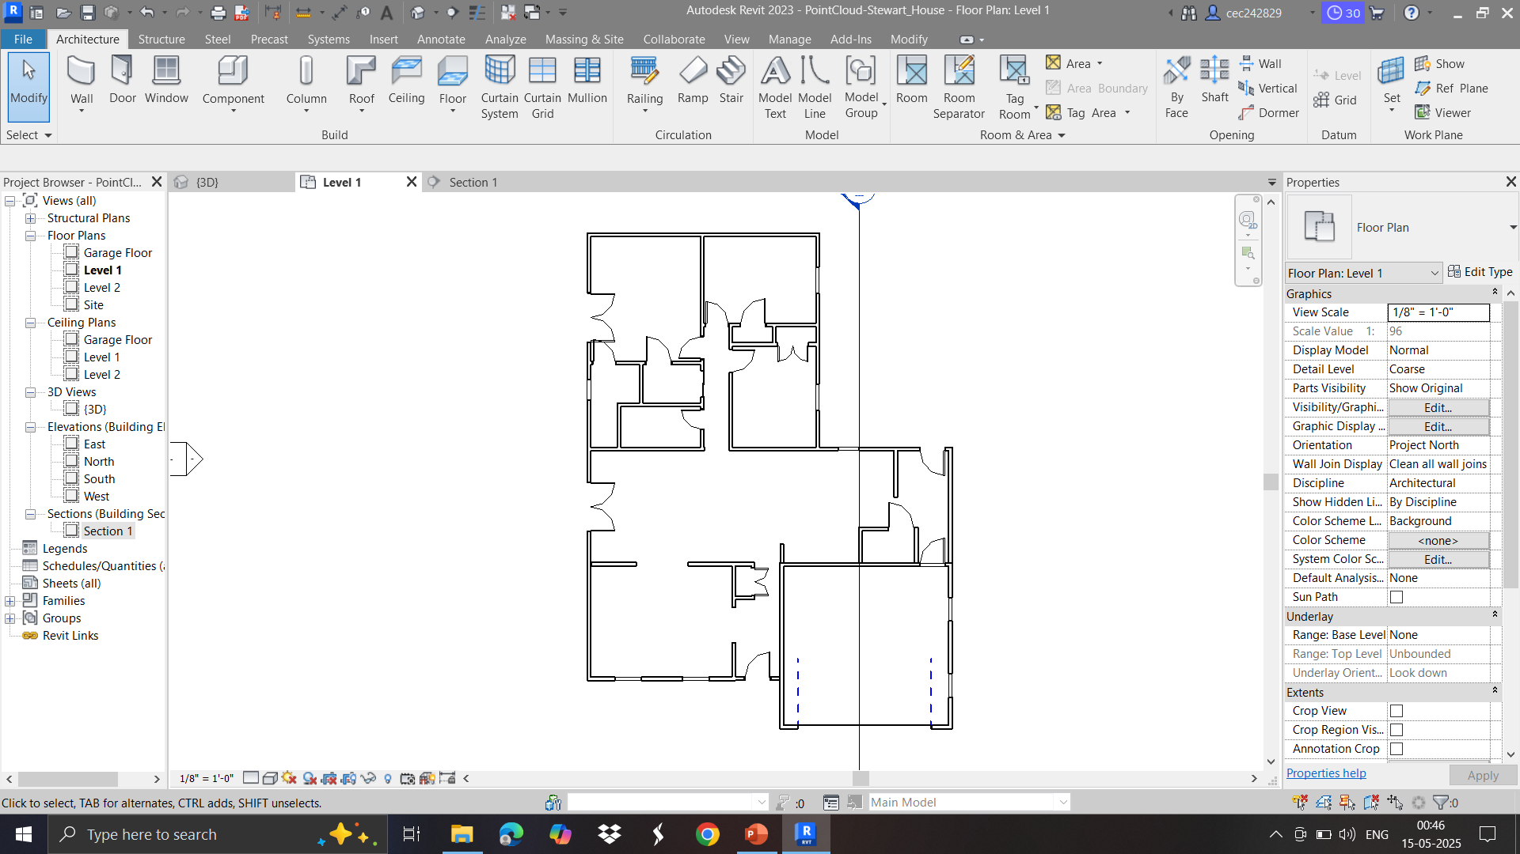
Addition of Doors (2D View)

Slide 16
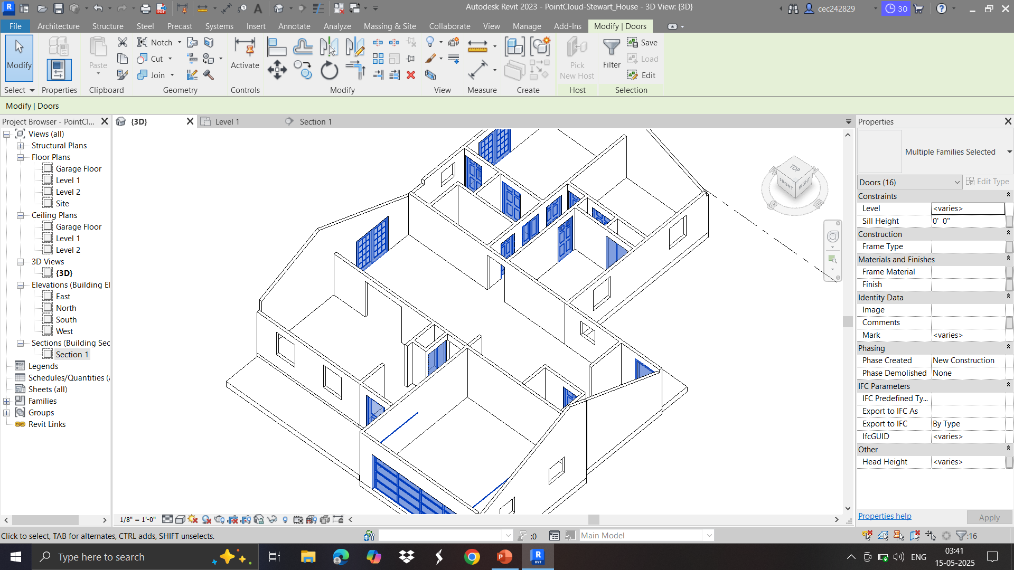
Addition of Doors (3D View)

Slide 17
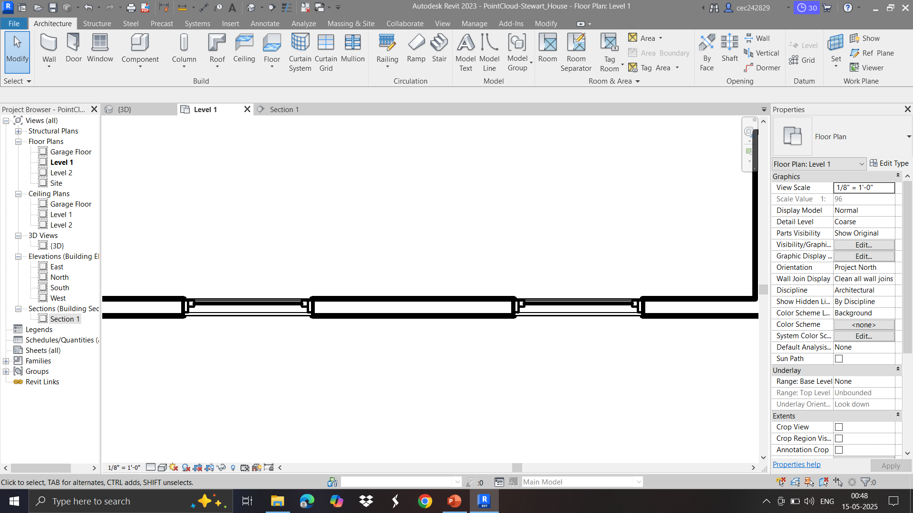
Addition of Windows (2D View)

Slide 18
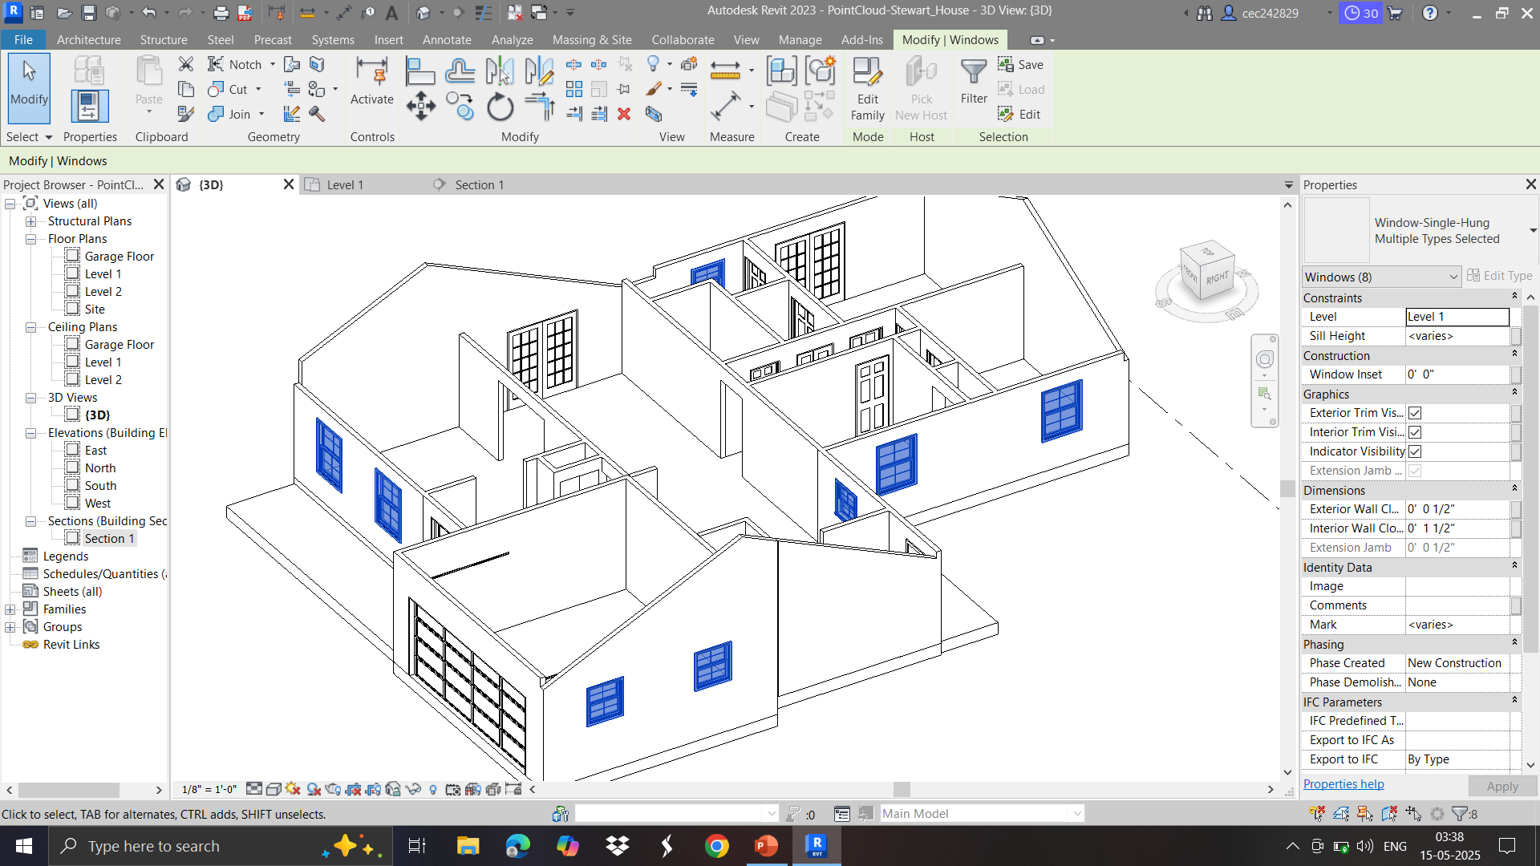
Addition of Windows (3D View)

Slide 19
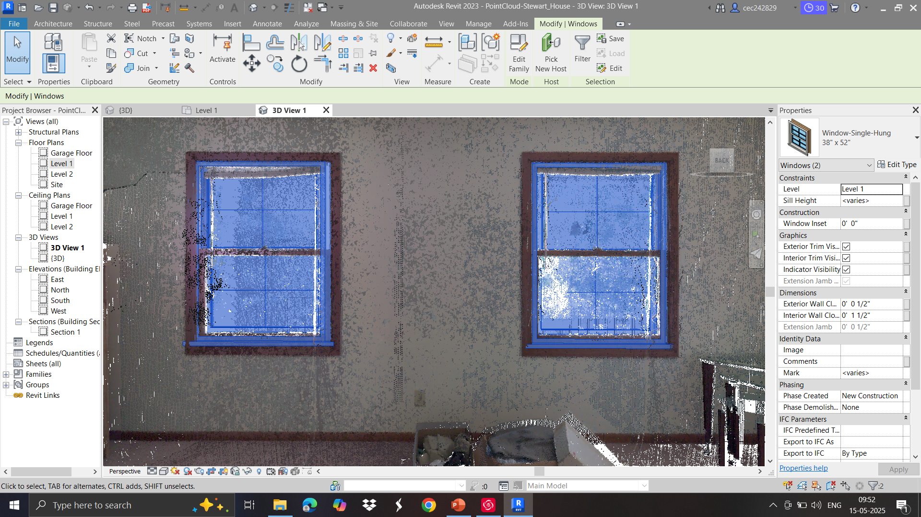
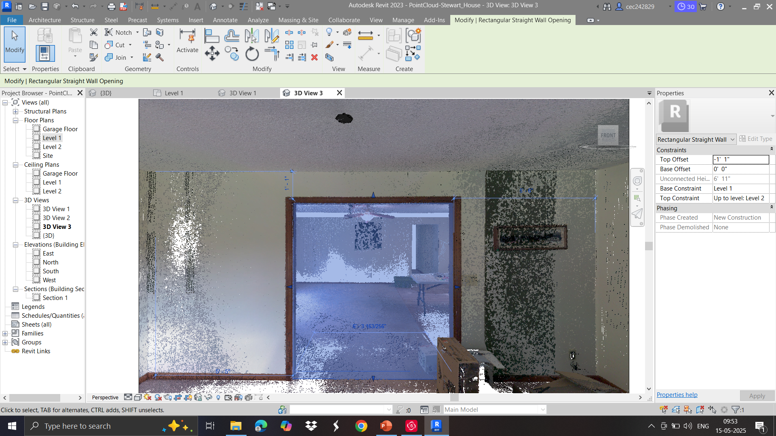
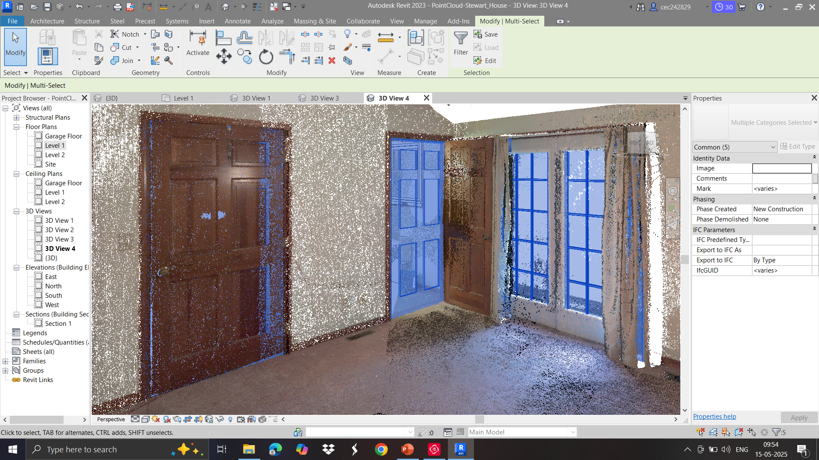
Adjustment of Windows, Wall Cuts, and Doors

Slide 20
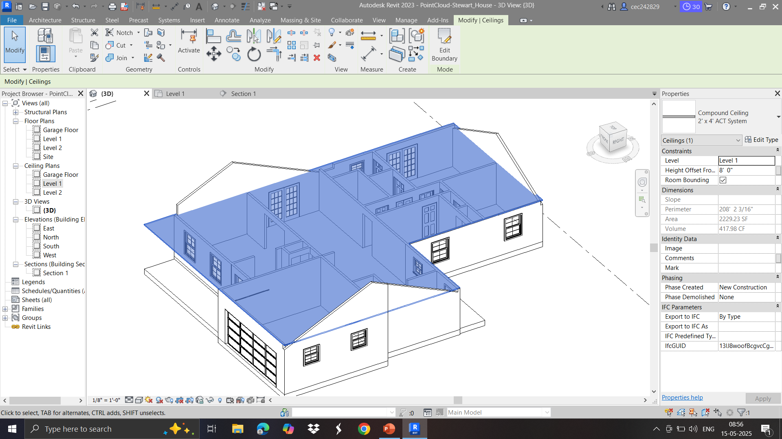
Addition of Ceiling (3D View)

Slide 21
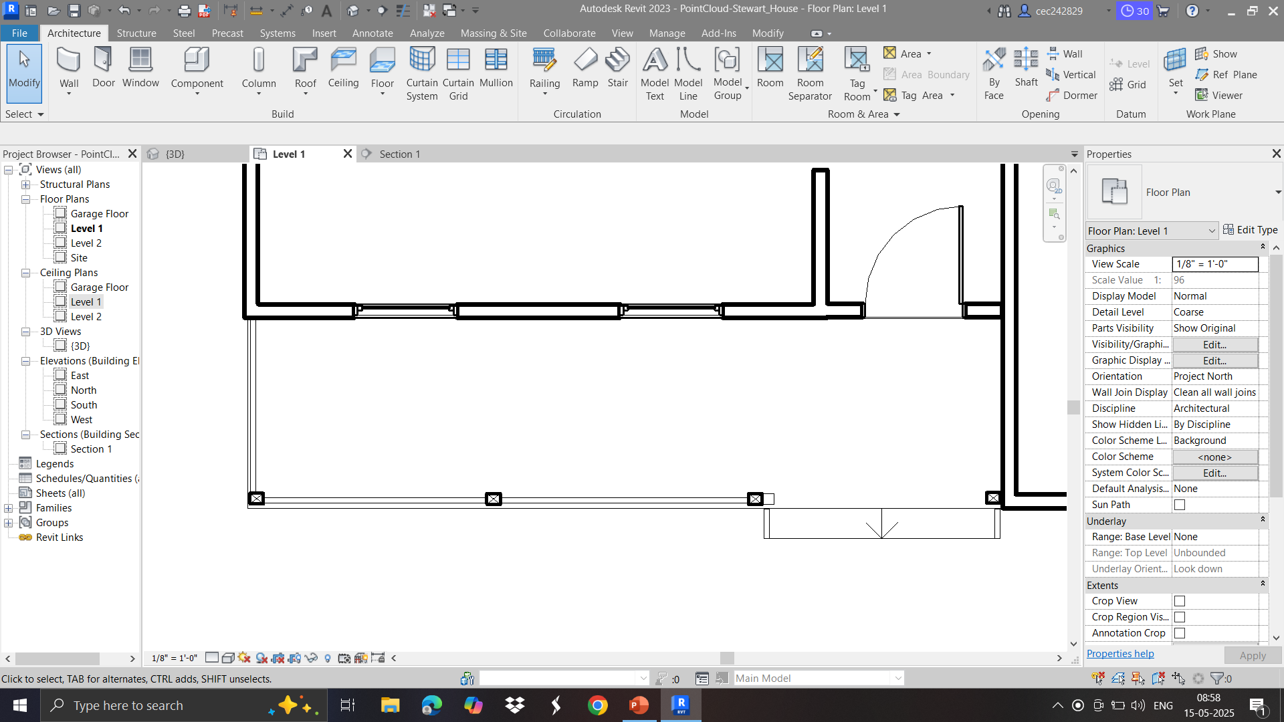
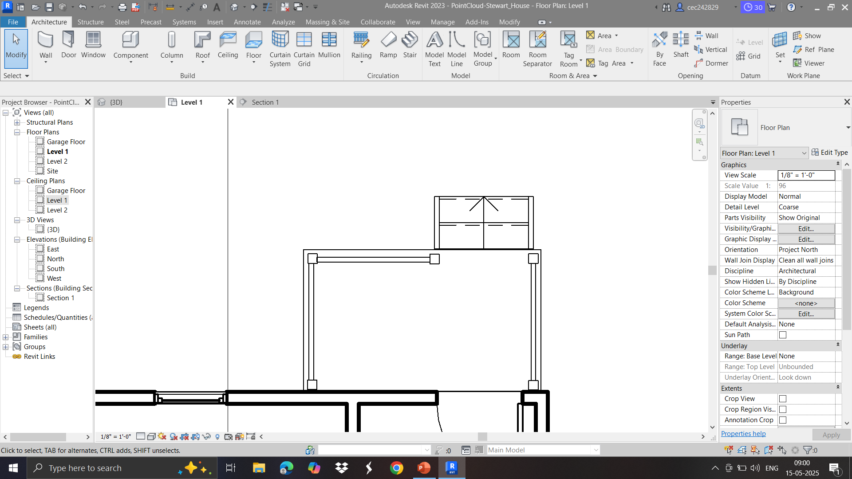
Addition of Column, Railings, and Stairs (2D View)

Slide 22
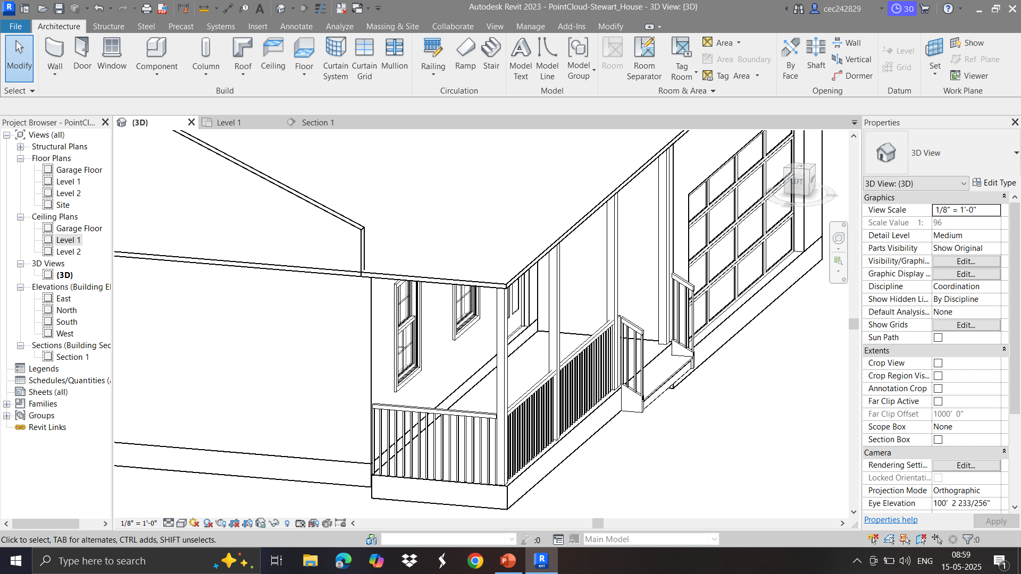
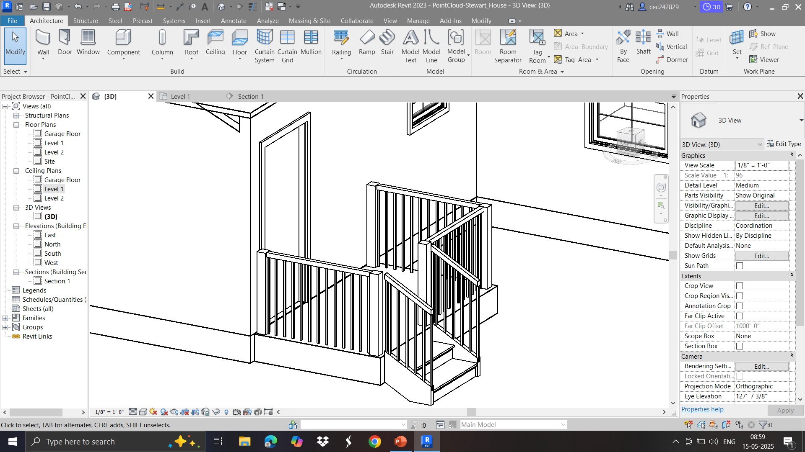
Addition of Column, Railings, and Stairs (3D View)

Slide 23
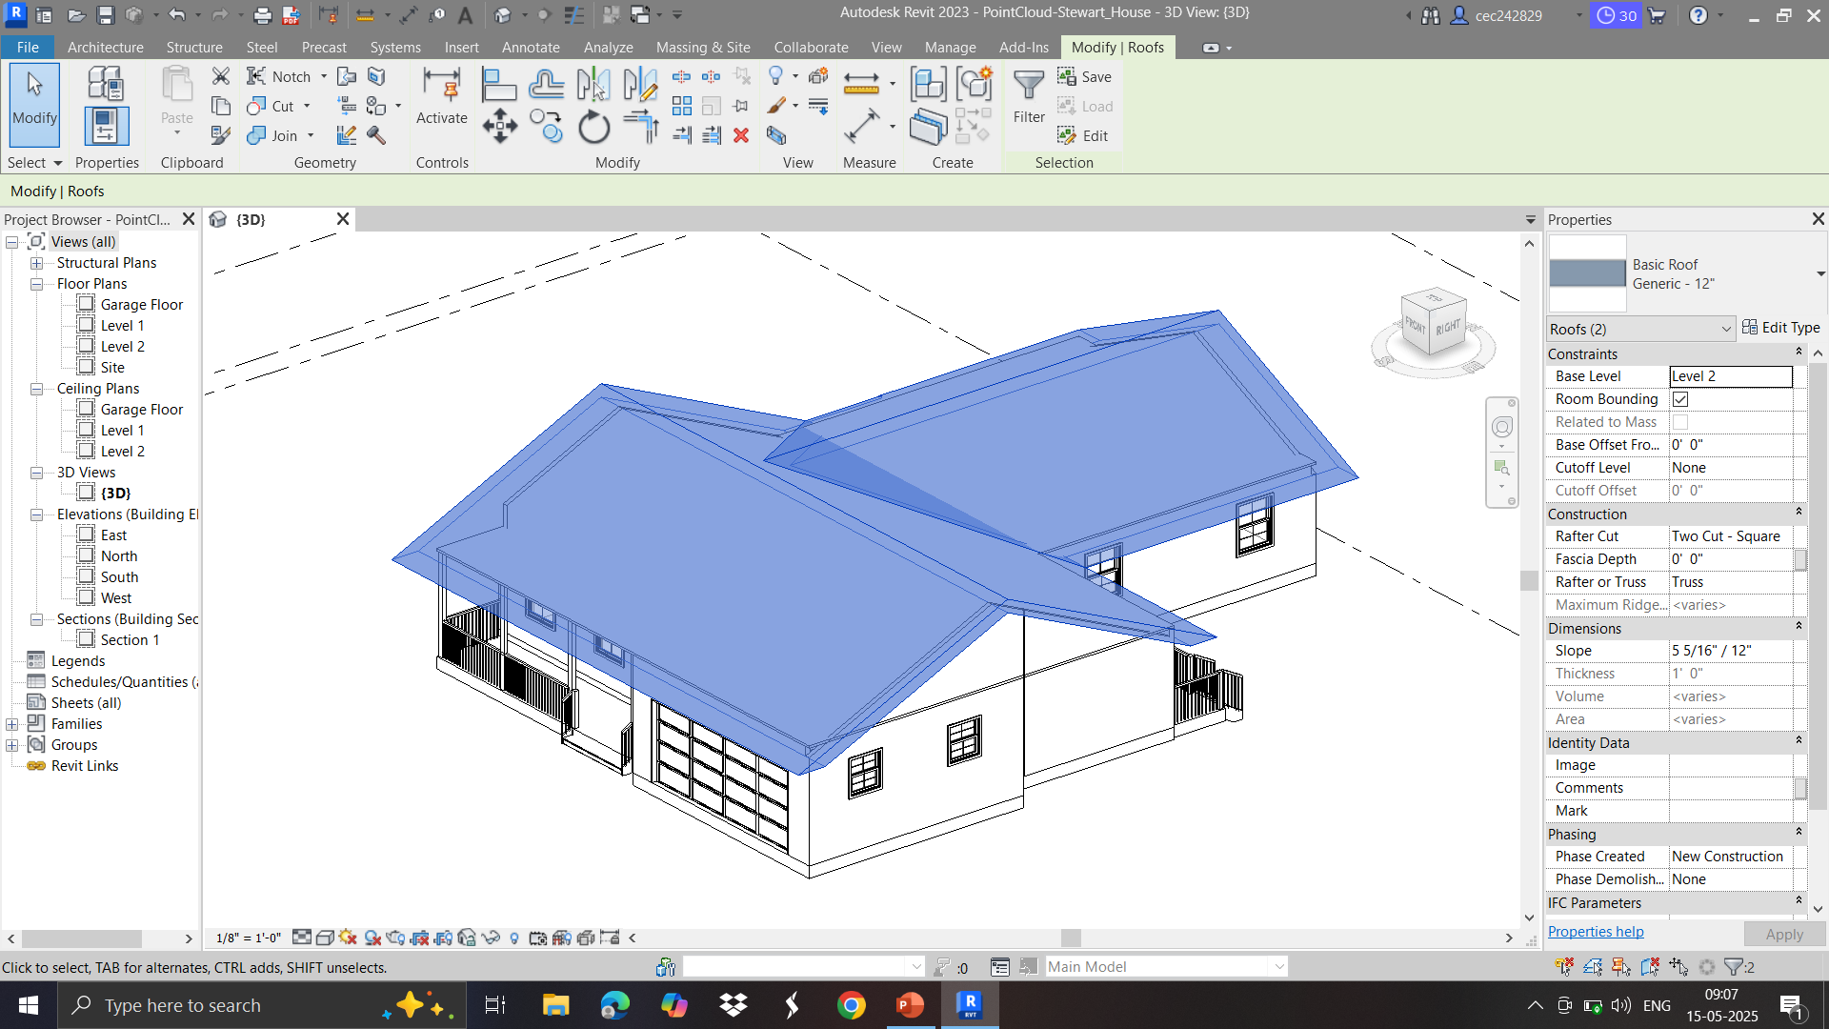
Addition of Roof (3D View)

Slide 24
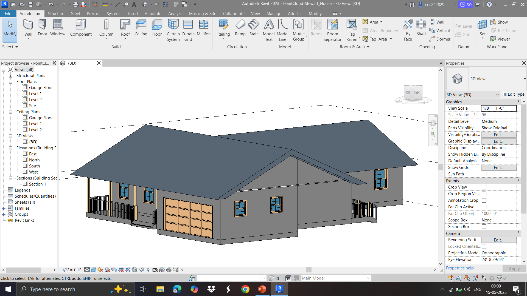
Completed 3D Model of house

Slide 25
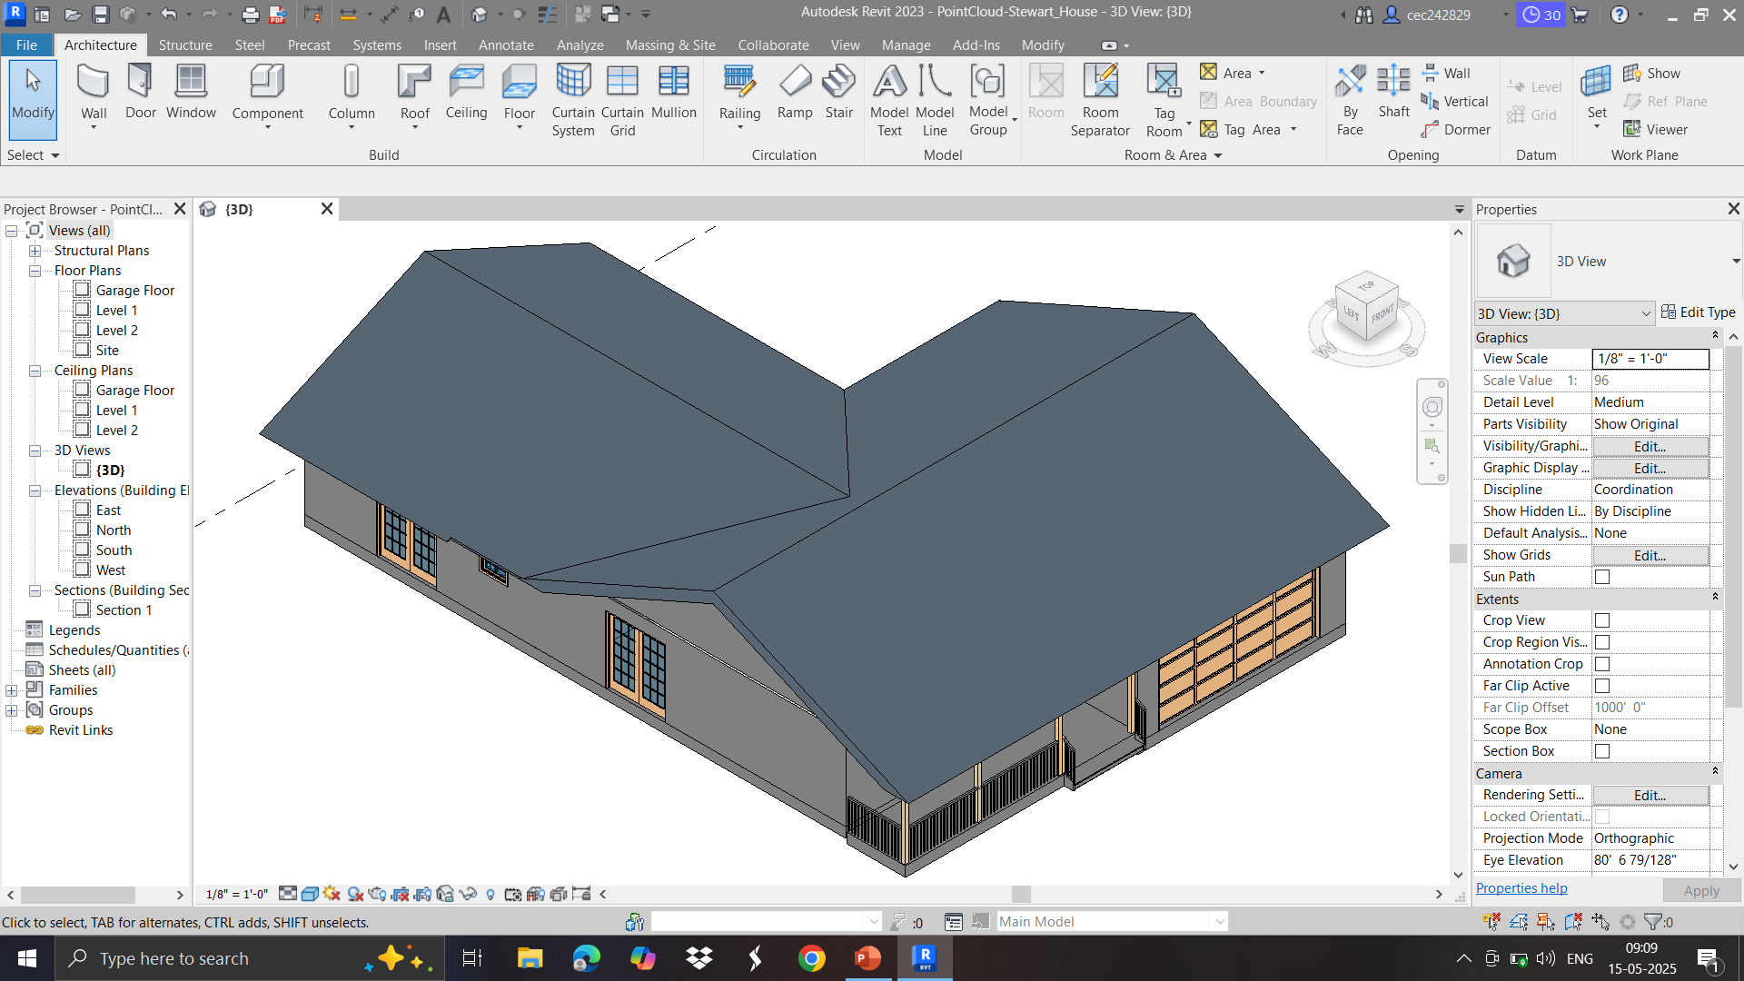
Completed 3D Model of house

Slide 26
Thankyou for your attention!

